Slide 1


Code +

Slide 2
Today
Syntax
Variable
Datatypes
Code +

Slide 3
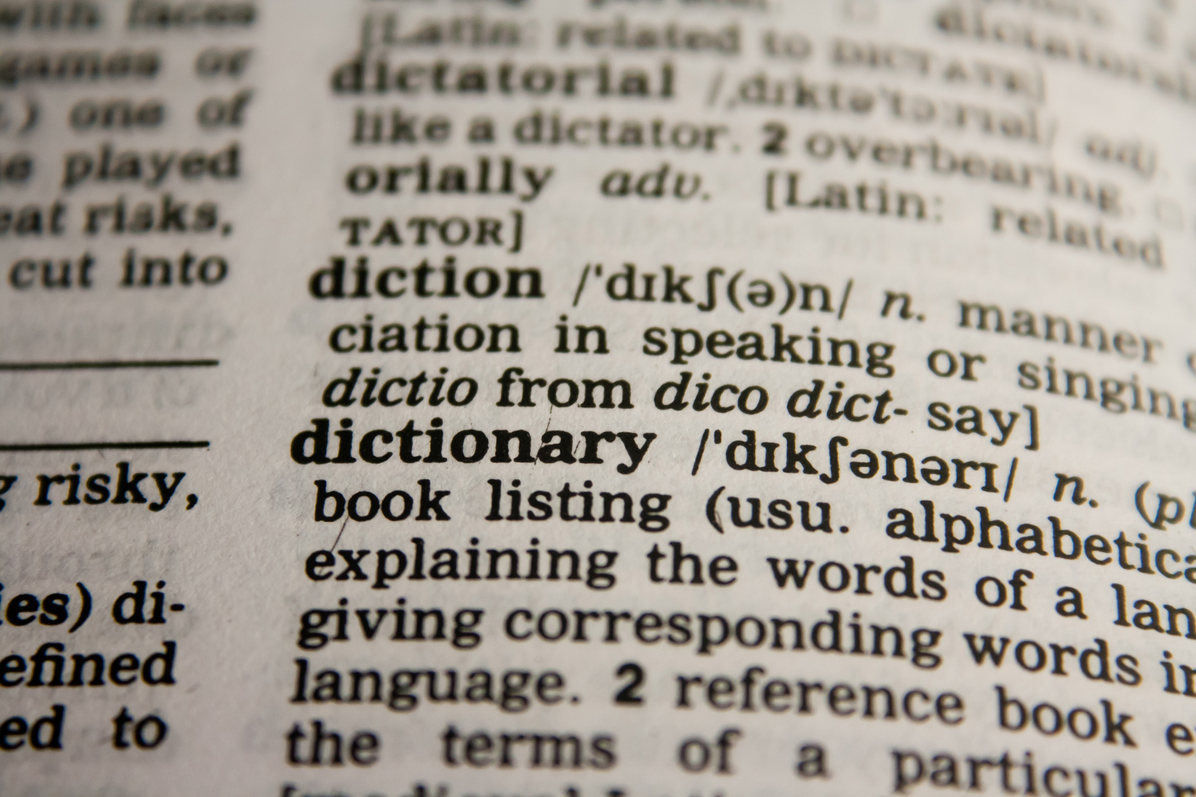
Syntax
import
def
“Jacob”
X = 3
print ()
for ()
class
elif
if
return
else
Code +

Slide 4
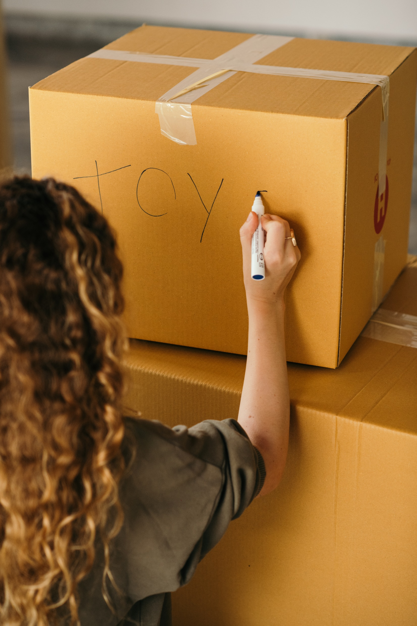
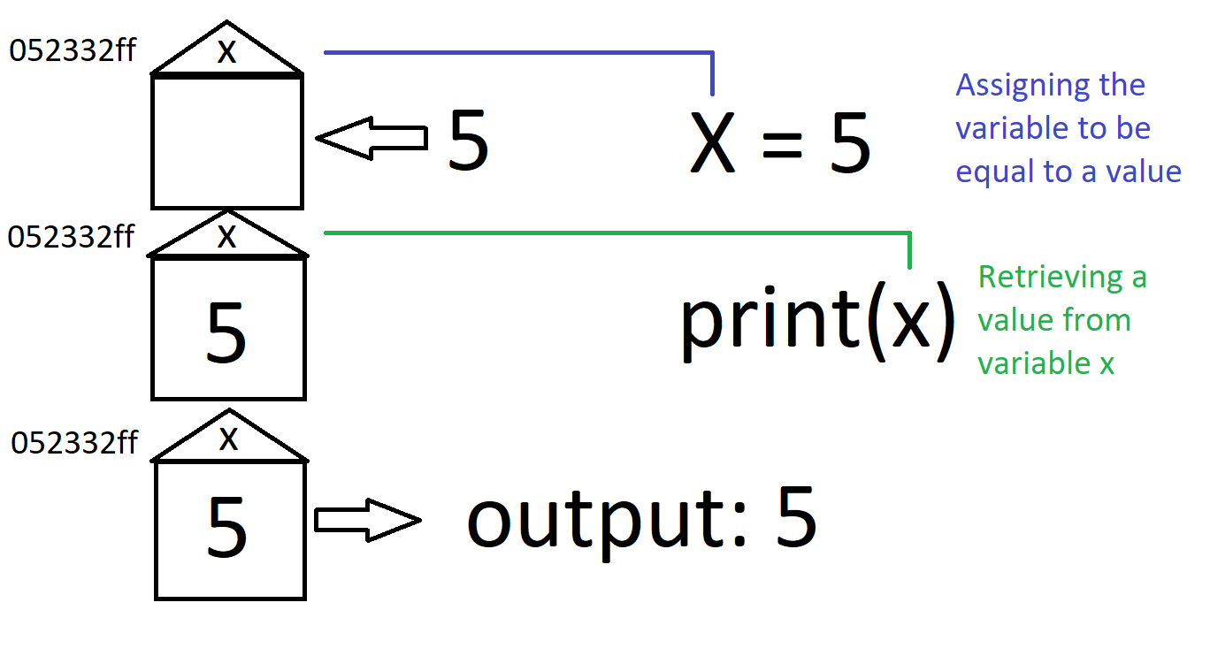
Variable
Code +

Slide 5
Data-types
Code +

Slide 6
integer
Syntax ; Variable ; Language
Expressions
If else conditions
For while do while loops
Guess Number Game
Code +

Slide 7
String
Lists Sets Dictionaries
For each loop
Functions
Parameters
Tic Tac Toe
Code +

Slide 8

boolean
OO programing?
Libraries?
Quest?
Code +

Slide 9
Task
Code +

